Slide 1





Asynchronous Programming and Promises
Promises. Async / Await
Promises
Promises
SoftUni Team
.then()
Technical Trainers
.catch()
Software University
http://softuni.bg

Slide 2



Table of Contents
Asynchronous Programming
Promises in JS – Concepts
Promises with AJAX
Using Async /
<number>

Slide 3
Have a Question?
sli.do #JSAPPS
<number>

Slide 4
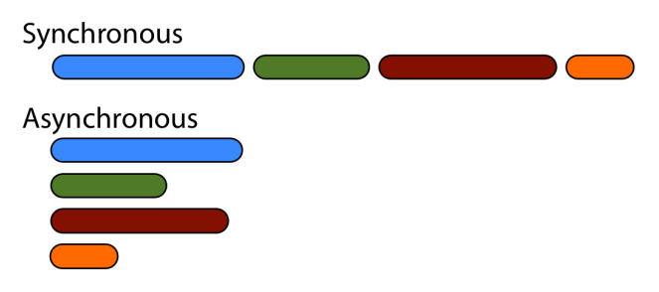
Asynchronous Programming

Slide 5
Asynchronous Programming in JS
Asynchronous programming deals with the needs to run several tasks (pieces of code) in parallel, in the same time
In JS the asynchronous programming is based on callbacks
You run a background task and pass a
<number>

Slide 6
Asynchronous Programming – Example
setTimeout(task1, 1000);
setTimeout(task2, 1500);
setTimeout(task3, 500);
console.log("All tasks started");
function task1() { console.log("task1 finished") }
function task2() { console.log("task2 finished") }
function task3() { console.log("task3 finished") }
3 tasks run in parallel and
will finish at different time
All tasks started
task3 finished
task1 finished
task2 finished
task1
All tasks run in parallel
task2
task3
<number>

Slide 7
Promises
.then()
.catch()
Promises in JS
Objects Holding Asynchronous Operations

Slide 8
What is a Promise?
A promise is an object holding an asynchronous operation
A result which may be available now, or in the future, or never
Promises may be in one of these states:
Pending – operation still running (unfinished)
Fulfilled – operation finished (and the result is available)
Failed – operation is failed (and an error is available)
Promises in JS use the Promise
<number>

Slide 9
JS Promises – Syntax
let p = new Promise(function(resolve, reject) {
// Do an async task and then resolve or reject
if (/* operation successful */)
resolve('Success!');
else /* operation failed */
reject('Failure!');
});
p.then(function(result) {
/* process the result (when the promise is resolved) */ })
.catch(function(error) {
/* handle the error (when the promise is rejected) */ });
<number>

Slide 10
Promise.then() – Example
console.log('Before promise');
new Promise(function(resolve, reject) {
setTimeout(function() {
resolve('done');
}, 500);
})
.then(function(result) {
console.log('Then returned: ' + result);
});
console.log('After promise');
Before promise
After promise
Then returned: done
Resolved after 500 ms
Check your solution here: https://judge.softuni.bg/Contests/360
<number>

Slide 11
Promise.catch() – Example
console.log('Before promise');
new Promise(function(resolve, reject) {
setTimeout(function() {
reject('fail');
}, 500);
})
.then(function(result) { console.log(result); })
.catch(function(error) { console.log(error); });
console.log('After promise');
Before promise
After promise
fail
Rejected after 500 ms
Check your solution here: https://judge.softuni.bg/Contests/360
<number>

Slide 12
Promise Execution
let p = new Promise(
function(resolve, reject) {
if (/* operation successful */)
resolve('Success!');
else /* operation failed */
reject('Failure!');
});
p.then(function(result) { … });
.catch(function(reason) { … });
Promise
executor
resolve
reject
<number>

Slide 13
JS Promises – Example – First Task
let p1 = new Promise(
function(resolve, reject) {
console.log("task1 started.");
setTimeout(function() {
resolve("task1 result");
console.log("task1 finished.");
}, 1000);
}
);
<number>

Slide 14
JS Promises – Example – Second Task
let p2 = new Promise(
function(resolve, reject) {
console.log("task2 started.");
setTimeout(function() {
resolve("task2 result");
console.log("task2 finished.");
}, 1500);
}
);
<number>

Slide 15
JS Promises – Example – Third Task
let p3 = new Promise(
function(resolve, reject) {
console.log("task3 started.");
// reject('cannot execute task3');
setTimeout(function() {
resolve("task3 result");
console.log("task3 finished.");
}, 500);
}
);
<number>

Slide 16
JS Promises – Example – Execution
console.log("All tasks started.");
Promise.all([p1, p2, p3])
.then(function(result) {
console.log("All tasks finished.");
console.log("Result: " + result.join(", "));
// nonExistingFunction();
})
.catch(function(error) {
console.log("Some of the tasks failed.");
console.log("Error: " + error);
});
Error in then() block will reject the promise
Check your solution here: https://judge.softuni.bg/Contests/360
<number>

Slide 17


Promises
.then()
.catch()
Promises with jQuery AJAX

Slide 18
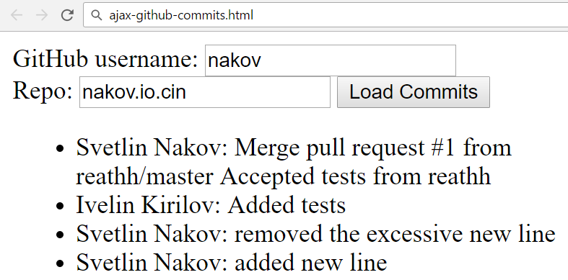
Problem: Load GitHub Commits with AJAX
GitHub username:
<input type="text" id="username" value="nakov" /> <br>
Repo: <input type="text" id="repo" value="nakov.io.cin" />
<button onclick="loadCommits()">Load Commits</button>
<ul id="commits"></ul>
<script>
function loadCommits() {
// AJAX call …
}
</script>
<number>

Slide 19
Solution: Load GitHub Commits with AJAX
function loadCommits() {
$("#commits").empty();
let url = "https://api.github.com/repos/" +
$("#username").val() + "/" +
$("#repo").val() + "/commits";
$.get(url)
.then(displayCommits)
.catch(displayError);
function displayCommits(commits) { … }
function displayError(err) { … }
}
jQuery AJAX methods return promises
<number>

Slide 20
Solution: Load GitHub Commits with AJAX (2)
function displayCommits(commits) {
for (let commit of commits)
$("#commits").append($("<li>").text(
commit.commit.author.name + ": " +
commit.commit.message
));
}
function displayError(err) {
$("#commits").append($("<li>").text("Error: " +
err.status + ' (' + err.statusText + ')'));
}
Check your solution here: https://judge.softuni.bg/Contests/360
<number>

Slide 21
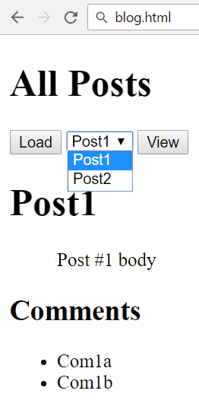
Problem: Blog (Posts with Comments)
Create a Kinvey app
Create user "peter" with password "p"
Create posts "Post1" and "Post2"
Create comments "Com1a" and "Com1b" for "Post1"
Create comments "Com2a", "Com2b" and "Com2c" for "Post2"
Write a JS app to display all posts and view selected post along with its
<number>

Slide 22
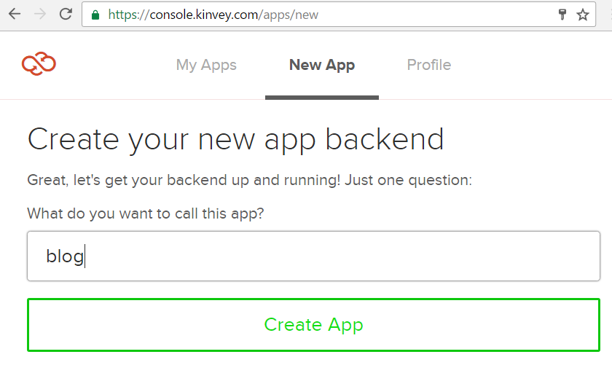
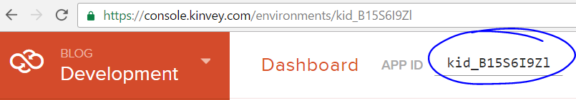
Solution: Blog – Create a Kinvey App
Remember your app ID
<number>

Slide 23
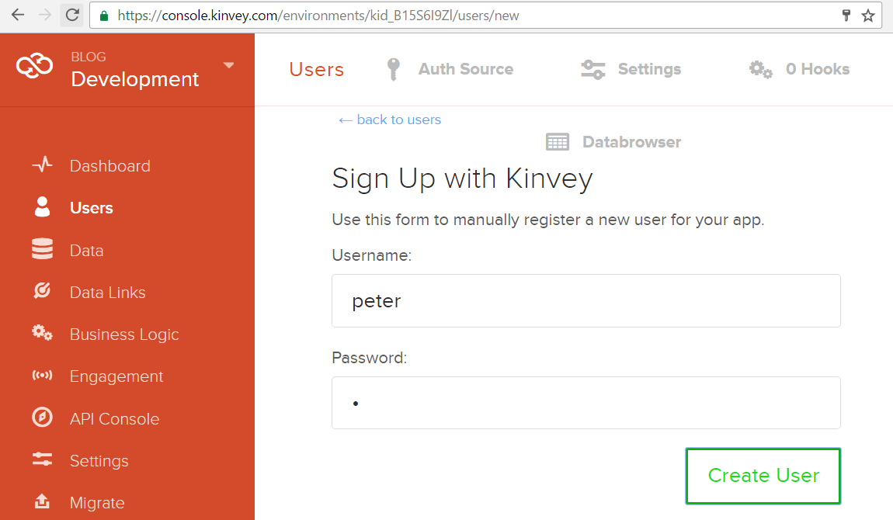
Solution: Blog – Create User "peter"
<number>

Slide 24
Solution: Blog – Create the First Post
Insert your Kinvey App ID here
POST /appdata/kid_B15S6I9Zl/posts/ HTTP/1.1
Host: baas.kinvey.com
Authorization: Basic Z3Vlc3Q6Z3Vlc3Q=
Content-Type: application/json
{ "title":"Post1", "body":"Post #1 body" }
Base64(user:pass)
{ "title": "Post1", "body": "Post #1 body", …,
"_id": "582cde77209db9d9730bab03" }
Remember the post _id
<number>

Slide 25
Solution: Blog – Create the Comments
POST /appdata/kid_B15S6I9Zl/comments/ HTTP/1.1
Host: baas.kinvey.com
Authorization: Basic Z3Vlc3Q6Z3Vlc3Q=
Content-Type: application/json
{ "text":"Com1a", "post_id":"582cde77209db9d9730bab03" }
Use post _id from the previous request
POST /appdata/kid_B15S6I9Zl/comments/ HTTP/1.1
Host: baas.kinvey.com
Authorization: Basic Z3Vlc3Q6Z3Vlc3Q=
Content-Type: application/json
{ "text":"Com2a", "post_id":"582cde77209db9d9730bab03" }
<number>

Slide 26
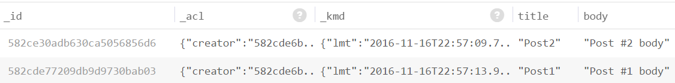
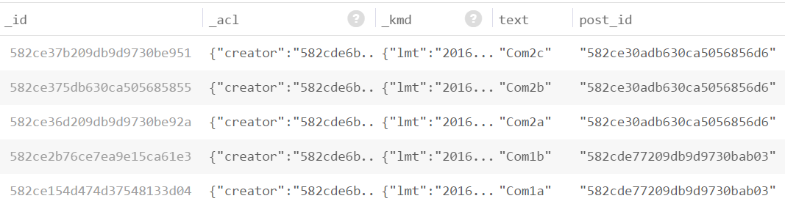
Solution: Blog – Create the Second Post
Create the second post "Post2" + its 3 comments
The "posts" and "comments" collections should look like these:
<number>

Slide 27
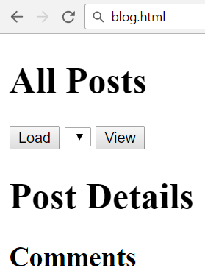
Solution: Blog – HTML Code
<script src="jquery-3.1.1.min.js"></script>
<script src="blog.js"></script>
<h1>All Posts</h1>
<button id="btnLoadPosts">Load</button>
<select id="posts"></select>
<button id="btnViewPost">View</button>
<h1 id="post-title">Post Details</h1>
<ul id="post-body"></ul>
<h2>Comments</h2>
<ul id="post-comments"></ul>
<number>

Slide 28
Solution: Blog – JS Code
$(document).ready(function() {
const kinveyAppId = "kid_B15S6I9Zl";
const serviceUrl = "https://baas.kinvey.com/appdata/" + kinveyAppId;
const kinveyUsername = "peter";
const kinveyPassword = "p";
const base64auth = btoa(kinveyUsername + ":" + kinveyPassword);
const authHeaders = { "Authorization": "Basic " + base64auth };
$("#btnLoadPosts").click(loadPostsClick);
$("#btnViewPost").click(viewPostClick);
function loadPostsClick() { … }
function viewPostClick() { … }
…
});
<number>

Slide 29
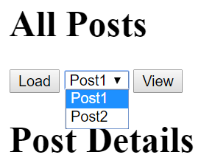
Solution: Blog – Load Posts
function loadPostsClick() {
let loadPostsRequest = {
url: serviceUrl + "/posts",
headers: authHeaders,
};
$.ajax(loadPostsRequest)
.then(displayPosts)
.catch(displayError);
}
<number>

Slide 30
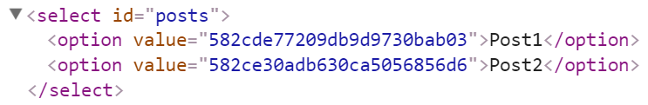
Solution: Blog – Display Posts as Options
function displayPosts(posts) {
$("#posts").empty();
for (let post of posts) {
let option = $("<option>")
.text(post.title)
.val(post._id);
$("#posts").append(option);
}
}
<number>

Slide 31
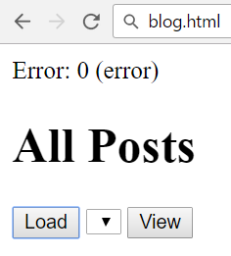
Solution: Blog – Handle AJAX Errors
function displayError(err) {
let errorDiv = $("<div>").text("Error: " +
err.status + ' (' + err.statusText + ')');
$(document.body).prepend(errorDiv);
setTimeout(function() {
$(errorDiv).fadeOut(function() {
$(errorDiv).remove();
});
}, 3000);
}
<number>

Slide 32
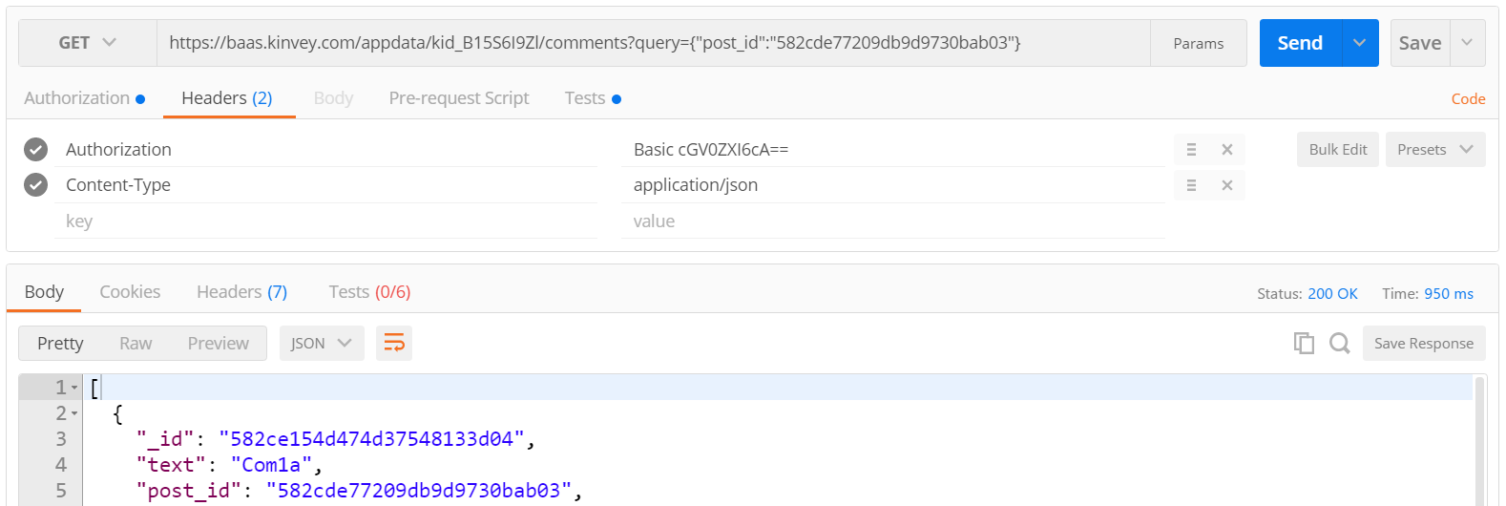
Solution: Blog – Load Post Comments Query
Kinvey allows querying collections:
https://baas.kinvey.com/appdata/kid_B15S6I9Zl/comments?query={"post_id":"582cde77209db9d9730bab03"}
<number>

Slide 33
Solution: Blog – [View Post] Button Click
function viewPostClick() {
let selectedPostId = $("#posts").val();
if (!selectedPostId) return;
let requestPosts = $.ajax({
url: serviceUrl + "/posts/" + selectedPostId,
headers: authHeaders });
let requestComments = $.ajax({ url: serviceUrl + `/comments/?query={"post_id":"${selectedPostId}"}`,
headers: authHeaders });
Promise.all([requestPosts, requestComments])
.then(displayPostWithComments)
.catch(displayError);
}
<number>

Slide 34
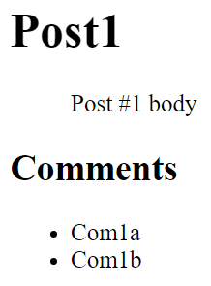
Solution: Blog – Display Post with Its Comments
function displayPostWithComments([post, comments]) {
$("#post-title").text(post.title);
$("#post-body").text(post.body);
$("#post-comments").empty();
for (let comment of comments) {
let commentItem = $("<li>")
.text(comment.text);
$("#post-comments")
.append(commentItem);
}
}
Check your solution here: https://judge.softuni.bg/Contests/360
<number>

Slide 35

Async / Await
Simplified Promises

Slide 36
Async / Await Simplify Promises
async function loadData() {
return new Promise(function(resolve, reject) {
setTimeout(function() { resolve('data'); }, 300);
});
}
async function loadMoreData(input) {
return new Promise(function(resolve, reject) {
setTimeout(function() {
resolve(input + ' + more data'); }, 200);
});
}
<number>

Slide 37
Async / Await Simplify Promises (2)
async function loadAllData() {
console.log('Before promise');
let data = await loadData();
let moreData = await loadMoreData(data);
console.log('Result: ' + moreData);
console.log('After promise');
}
loadAllData();
console.log('Finished');
Before promise
Finished
Result: data + more data
After promise
<number>

Slide 38
Transpiling Async / Await with Babel
npm install -g babel-cli
npm install -g babel-plugin-transform-async-to-generator
.babelrc
{
"plugins": ["transform-async-to-generator"]
}
babel async-await.js -o async-await-transpiled.js
<number>

Slide 39

Promises
.then()
.catch()
Practice: Promises, AJAX, Async / Await
Live Exercises in Class (Lab)

Slide 40


Summary
Promises hold operations (background tasks)
Can be resolved or rejected
p.then(function(result) {
/* process the result */ })
.catch(function(error) {
/* handle the error */ });
$.ajax(request)
.then(function(data) { … })
.catch(function(error) { … });
<number>

Slide 41







AJAX and jQuery AJAX
https://softuni.bg/courses/
Notes:
© Software University Foundation – http://softuni.org
This work is licensed under the Creative Commons Attribution-NonCommercial-ShareAlike license.
<number>

Slide 42
License
This course (slides, examples, demos, videos, homework, etc.) is licensed under the "Creative Commons Attribution-NonCommercial-ShareAlike 4.0 International" license
<number>
Notes:
© Software University Foundation – http://softuni.org
This work is licensed under the Creative Commons Attribution-NonCommercial-ShareAlike license.
<number>

Slide 43





Free Trainings @ Software University
Software University Foundation – softuni.org
Software University – High-Quality Education, Profession and Job for Software Developers
softuni.bg
Software University @ Facebook
facebook.com/SoftwareUniversity
Software University Forums
forum.softuni.bg
Notes:
© Software University Foundation – http://softuni.org
This work is licensed under the Creative Commons Attribution-NonCommercial-ShareAlike license.
<number>

